Slide 1
JPSS-1 vs S-NPP VIIRS SDR LUT Comparison: VIIRS-SDR-RTA-ER-LUT
Zhuo (Julie) Wang^{1,2} and Changyong Cao³
¹CICS/ESSIC, University of Maryland, College Park
²NOAA/NESDIS/STAR Affiliate
³ NOAA/NESDIS/STAR
October 6, 2015

Slide 2
RTA Emitted Radiance
Names of the compared LUT files:
S-NPP:
55142d9d-4f246-9d9b6c03-b3a1a2d6.VIIRS-SDR-RTA-ER-LUT_J01_20020101010000Z_20020101010000Z_ee00000000000000Z_PS-1-D-NPP-2-PE-_adv-_ops_all-_all.bin
JPSS-1:
VIIRS-SDR-RTA-ER-LUT_j01_20150724000000Z_20150724000000Z_ee00000000000000Z_PS-v1-BE-PE-_all-_dev_all-_all.bin
2
2
2

Slide 3
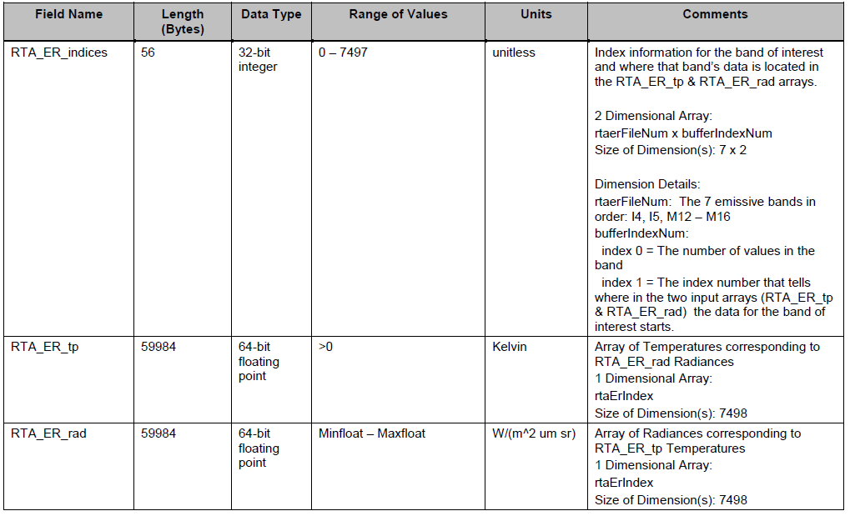
RTA Emitted Radiance

Slide 4
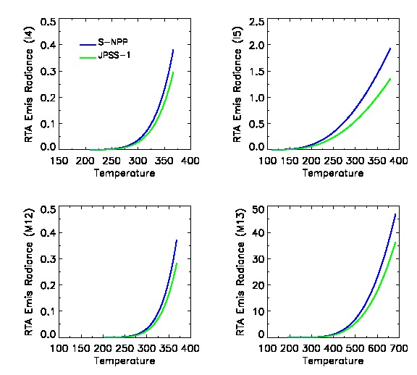
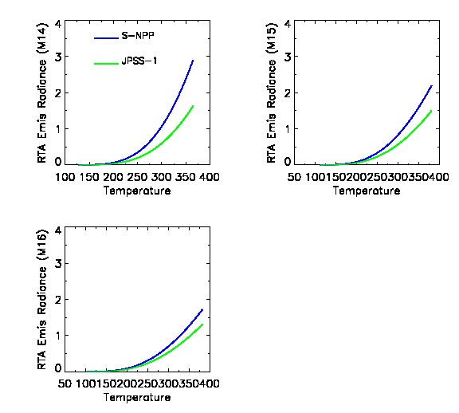
RTA Emitted Radiance
In general J1 has lower radiance than SNPP.
The radiance difference becomes larger as the temperature increases.
The difference between J1 and SNPP in I4 and M12 is smaller than those in other TEB bands.
4
4
4
4
4
4
4

Slide 5
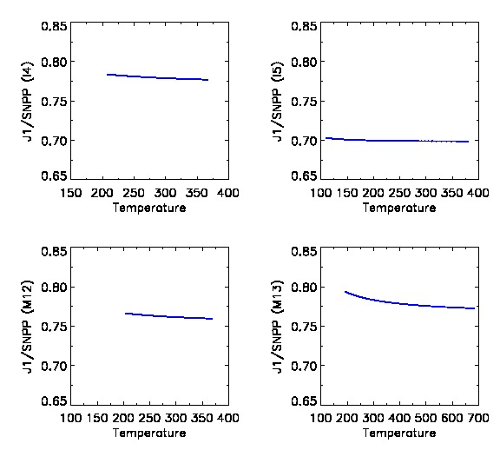
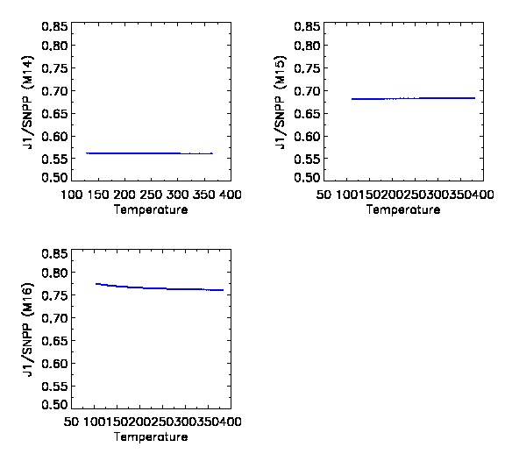
J1/SNPP RTA Emitted Radiance Ratio
The ratio J1/SNPP is almost constant for all bands, so the difference is likely caused by using different RTA reflectance.
The large difference is from bands I5, M14, and M15.
5
5
5
5
5
5

Slide 6
RTA Reflectance used for J1 RTA ER
The transmittance through the RTA:
I4 I5 M12 M13 M14 M5 M16 M16A M16B
ρ_rta = [0.9402, 0.9443, 0.9401, 0.9435, 0.9414, 0.9446, 0.9441, 0.9441, 0.9441]
Courtesy of VCST /NASA GSFC Presentation:
JPSS-1 VIIRS radiometric calibration LUTs (Jinan Zeng and Jeff Mclntire)

