Slide 1
JPSS-1 vs S-NPP VIIRS SDR LUT Comparison: VIIRS-SDR-OBC-RR-LUT
Zhuo (Julie) Wang^{1,2} and Changyong Cao³
¹CICS/ESSIC, University of Maryland, College Park
²NOAA/NESDIS/STAR Affiliate
³ NOAA/NESDIS/STAR
October 6, 2015

Slide 2
OBC BB Reflected Radiance
Names of the compared LUT files:
S-NPP:
55142d97-c0566-9d9b6c03-b3a8b5f0.VIIRS-SDR-OBC-RR-LUT_J01_20020101010000Z_20020101010000Z_ee00000000000000Z_PS-1-D-NPP-2-PE-_adv-_ops_all-_all.bin
JPSS-1:
VIIRS-SDR-OBC-RR-LUT_j01_20150724000000Z_20150724000000Z_ee00000000000000Z_PS-v1-BE-PE-_all-_dev_all-_all.bin
2

Slide 3
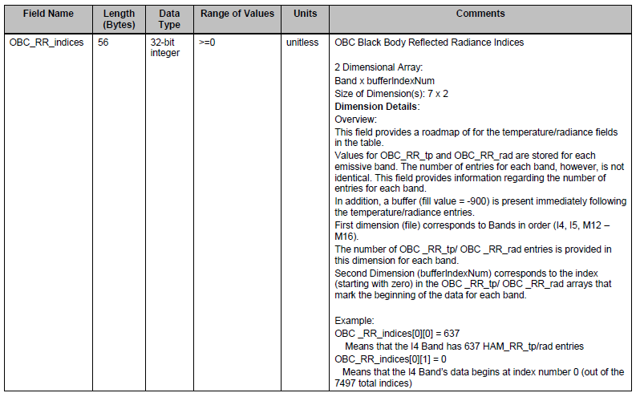
OBC BB Reflected Radiance Format
3
3

Slide 4
OBC BB Reflected Radiance Format
4
4

Slide 5
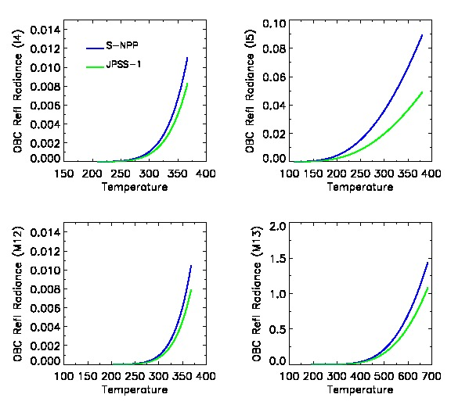
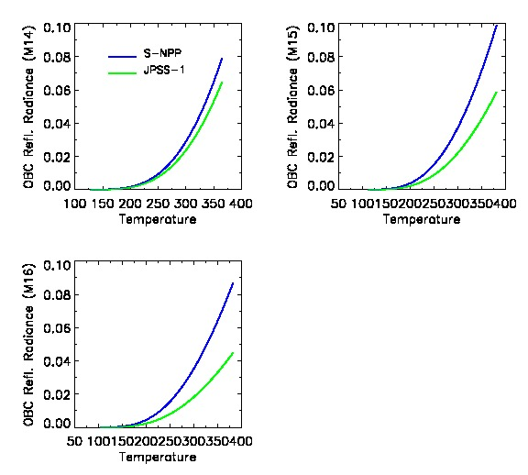
OBC Reflected Radiance (RR) LUT
In general J1 has lower radiance than SNPP.
The radiance difference becomes larger as the temperature increases.
The difference between J1 and SNPP in I4 and M12 is smaller than those in other TEB bands.
5

Slide 6
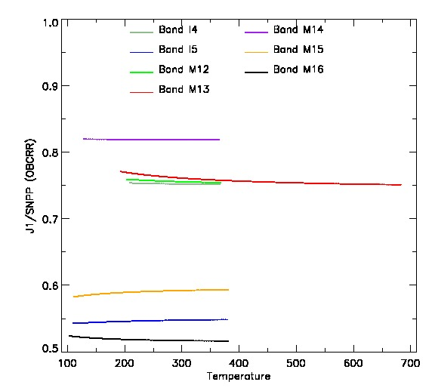
Ratio J1/SNPP of OBC RR LUT for 7 TEB Bands
The ratio J1/SNPP is almost
constant for all bands, so the
difference is likely caused by
using different OBCBB reflectance.
The large difference is still from
bands I5, M15, and M16.
6
6
6

Slide 7
OBCBB Emissivity for J1 OBCBB RR
Blackbody emissivity:
I4 I5 M12 M13 M14
Emiss_bb=[0.998219741, 0.99786055, 0.998219741, 0.998215829, 0.997522568,
0.997710199, 0.997974189, 0.997974189, 0.997974189]
M15 M16 M16A M16B
Courtesy of VCST /NASA GSFC Presentation:
JPSS-1 VIIRS radiometric calibration LUTs (Jinan Zeng and Jeff Mclntire)

