Slide 1
JPSS-1 vs S-NPP VIIRS SDR LUT Comparison: VIIRS-SDR-EMISSIVE-ER-LUT
Zhuo (Julie) Wang^{1,2} and Changyong Cao³
¹CICS/ESSIC, University of Maryland, College Park
²NOAA/NESDIS/STAR Affiliate
³ NOAA/NESDIS/STAR
October 6, 2015

Slide 2
OBCBB Emissivity LUT
Names of the compared LUT files:
S-NPP:
55142d91-20987-9d9b6c03-b39eba0b.VIIRS-SDR-EMISSIVE-LUT_J01_20020101010000Z_20020101010000Z_ee00000000000000Z_PS-1-D-NPP-1-PE-_adv-_ops_all-_all.bin
JPSS-1:
VIIRS-SDR-EMISSIVE-LUT_j01_20150724000000Z_20150724000000Z_ee00000000000000Z_PS-v1-BE-PE-_all-_dev_all-_all.bin

Slide 3
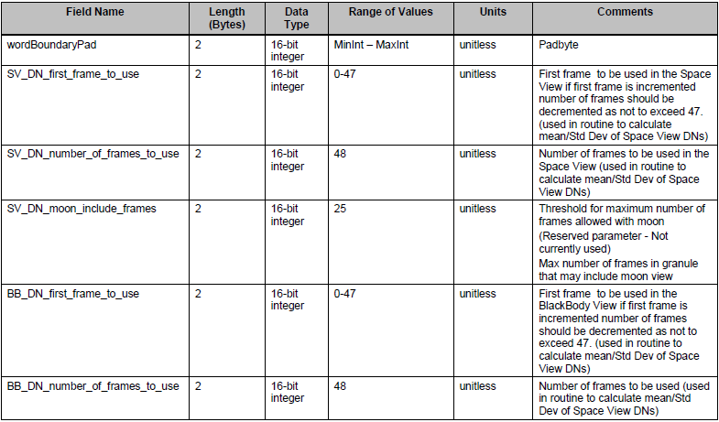
OBCBB Emissivity LUT Format

Slide 4
OBCBB Emissivity LUT Format

Slide 5
VIIRS SDR Emissivity LUT
S-NPP and JPSS-1 LUT are same.
wordBoundaryPad= 0
SV_DN_first_frame_to_use= 0
SV_DN_number_of_frames_to_use= 48
SV_DN_moon_include_frames=25 (Max number of frames in granule
that includes moon view).
BB_DN_first_frame_to_use= 0
BB_DN_number_of_frames_to_use= 48
T_mit_function_flag= 1 1 (Not used in code)
T_mir_default= 265.000 (Not used in code)
BB_Weight= 1.00000 1.00000 1.00000 1.00000 1.00000
1.00000
5

