Slide 1
JPSS-1 vs S-NPP VIIRS SDR LUT Comparison: VIIRS-SDR-OBC-ER-LUT
Zhuo (Julie) Wang^{1,2} and Changyong Cao³
¹CICS/ESSIC, University of Maryland, College Park
²NOAA/NESDIS/STAR Affiliate
³ NOAA/NESDIS/STAR
October 6, 2015

Slide 2
OBC Emitted Radiance LUT
Names of the compared LUT files:
S-NPP:
55142d96-a646d-9d9b6c03-b3a714f6.VIIRS-SDR-OBC-ER-LUT_J01_20020101010000Z_20020101010000Z_ee00000000000000Z_PS-1-D-NPP-2-PE-_adv-_ops_all-_all.bin
JPSS-1:
VIIRS-SDR-OBC-ER-LUT_j01_20150724000000Z_20150724000000Z_ee00000000000000Z_PS-v1-BE-PE-_all-_dev_all-_all.bin
2

Slide 3
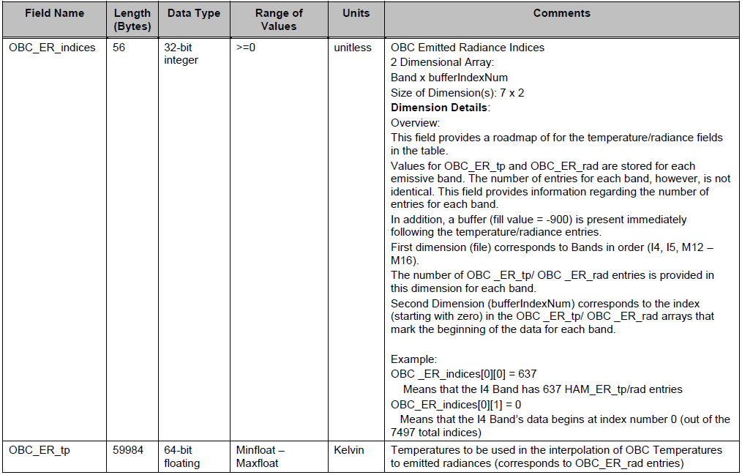
OBC Emitted Radiance LUT

Slide 4
OBC Emitted Radiance LUT

Slide 5
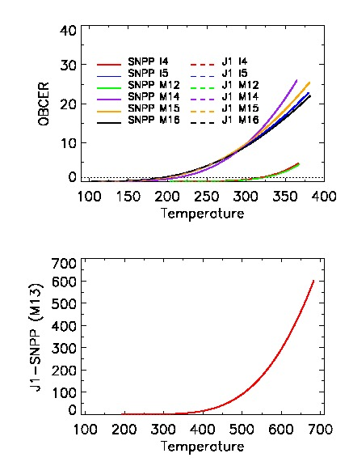
OBC Emitted Radiance (ER) LUT
Top panel: I4, I5, M12, M14, M15, M16
Bottom panel: M13
Radiance vs. Temperatures lines from
SNPP and J1 Mx8.5 are almost overlapped.
The following bands have similar radiance and temp ranges:
I4 and M12 (smallest radiance)
I5, M14, M15, and M16
M13 (largest radiance)
5

Slide 6
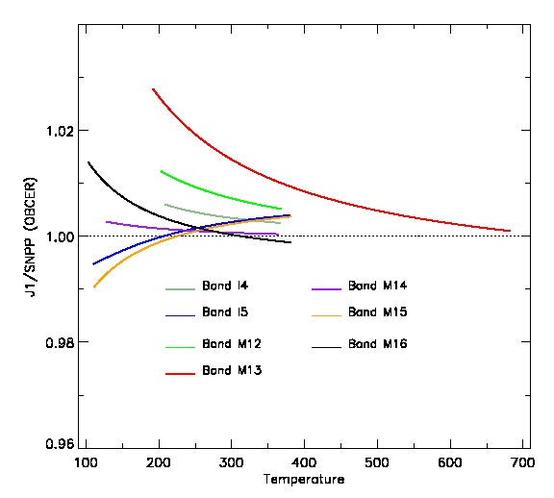
Ratio J1/SNPP of OBC ER LUT for 7 TEB Bands
The ratio are monotonic
function for all TEB bands.
The ratios in M15 and M16 have converse pattern.
At high, J1 has larger radiance than SNPP for all bands except for M16.
6
6

Slide 7
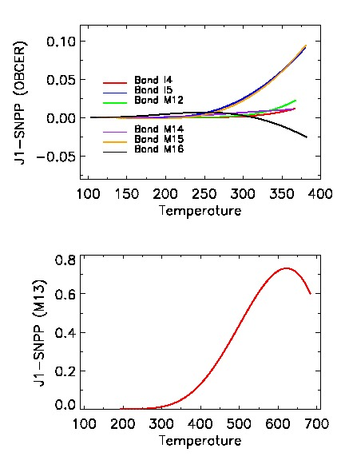
Difference J1−SNPP of OBC ER LUT
for 7 TEB Bands
The largest radiance is in band M13,
and it can be up to 0.73 W/m²-μm-Sr.
At high temperature, I4, M12, and M14
have small radiance difference between
J1 and SNPP.
The radiance difference in I5 and M15 can be up to 0.1 W/m²-μm-Sr.
7
7

Slide 8
OBCBB Emissivity for J1 OBCBB ER
Blackbody emissivity:
I4 I5 M12 M13 M14
Emiss_bb=[0.998219741, 0.99786055, 0.998219741, 0.998215829, 0.997522568,
0.997710199, 0.997974189, 0.997974189, 0.997974189]
M15 M16 M16A M16B
Courtesy of VCST /NASA GSFC Presentation:
JPSS-1 VIIRS radiometric calibration LUTs (Jinan Zeng and Jeff Mclntire)

