Slide 1
JPSS-1 vs S-NPP VIIRS SDR LUT Comparison: VIIRS-SDR-HAM-ER-LUT
Zhuo (Julie) Wang^{1,2} and Changyong Cao³
¹CICS/ESSIC, University of Maryland, College Park
²NOAA/NESDIS/STAR Affiliate
³ NOAA/NESDIS/STAR
October 6, 2015

Slide 2
HAM Emitted Radiance
Names of the compared LUT files:
S-NPP:
55142d95-c6a67-9d9b6c03-b3a91aef.VIIRS-SDR-HAM-ER-LUT_J01_20020101010000Z_20020101010000Z_ee00000000000000Z_PS-1-D-NPP-2-PE-_adv-_ops_all-_all.bin
JPSS-1:
VIIRS-SDR-HAM-ER-LUT_j01_20150724000000Z_20150724000000Z_ee00000000000000Z_PS-v1-BE-PE-_all-_dev_all-_all.bin
2
2

Slide 3
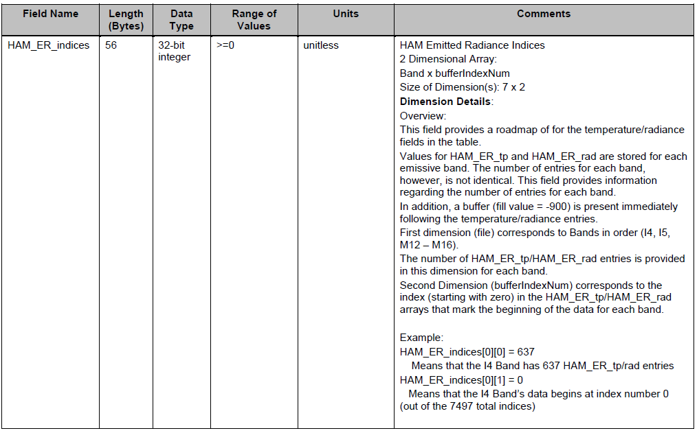
HAM Emitted Radiance Format

Slide 4
HAM Emitted Radiance Format
4

Slide 5
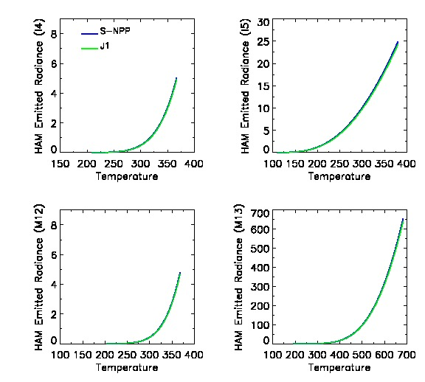
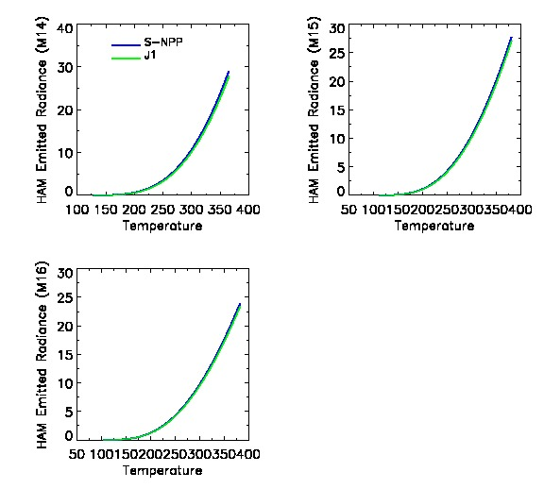
HAM Emitted Radiance (ER) LUT
HAM emitted radiance from J1 and SNPP agree with each other well for
all TEB bands.
5
5
5
5
5

Slide 6
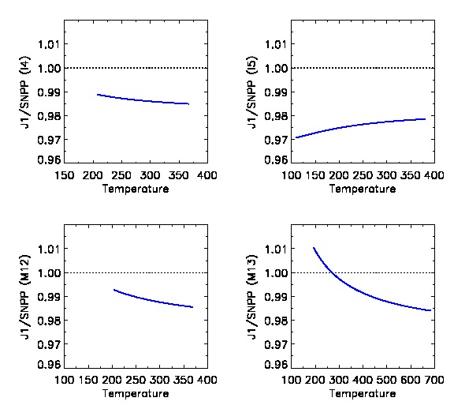
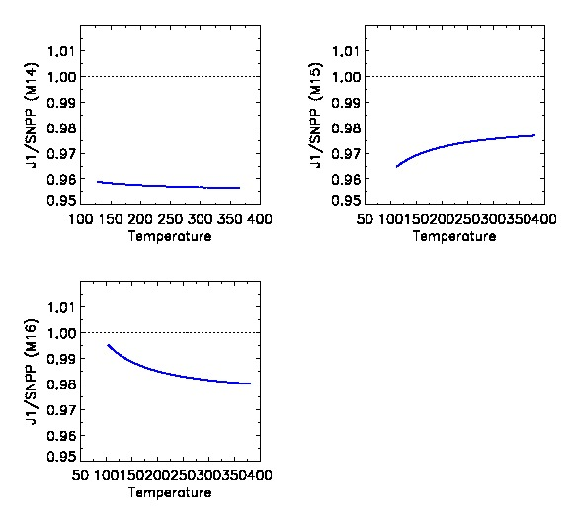
J1/SNPP HAM Emitted Radiance Ratio
HAM emitted ratio is between 0.95 and 1.01.
In most TEB bands, J1 is slightly smaller than SNPP except for M13 at temperature
lower than 270K.
6
6
6
6

Slide 7
RTA Reflectance Used for J1 HAM ER
The transmittance through the RTA:
I4 I5 M12 M13 M14 M5 M16 M16A M16B
ρ_rta = [0.9402, 0.9443, 0.9401, 0.9435, 0.9414, 0.9446, 0.9441, 0.9441, 0.9441]
Courtesy of VCST /NASA GSFC Presentation:
JPSS-1 VIIRS radiometric calibration LUTs (Jinan Zeng and Jeff Mclntire)

