Slide 1
JPSS-1 vs S-NPP VIIRS SDR LUT Comparison: VIIRS-SDR-EBBT-LUT
Zhuo (Julie) Wang^{1,2} and Changyong Cao³
¹CICS/ESSIC, University of Maryland, College Park
²NOAA/NESDIS/STAR Affiliate
³ NOAA/NESDIS/STAR
October 6, 2015

Slide 2
Radiance to Effective Blackbody Temperature (EBBT)
S-NPP (Mx8.5):
55142d8e-0ccb5-9d9b6c03-b39d7d36.VIIRS-SDR-EBBT-LUT_J01_
20020101010000Z_20020101010000Z_ee00000000000000Z_PS-1-D-NPP-2-PE-_adv-_ops_all-_all.bin
JPSS-1 (Mx8.5):
VIIRS-SDR-EBBT-LUT_j01_20150724000000Z_20150724000000Z_
ee00000000000000Z_PS-v1-mx8-5-BE-PE-_all-_dev_all-_all.bin
S-NPP (Mx8.10):
550bf6c5-4852d-9b9deadd-f0ae016f.VIIRS-SDR-EBBT-LUT_npp_
20150227000000Z_20150511000000Z_ee00000000000000Z_PS-1-O-CCR-15-2321-JPSS-DPA-002-PE_noaa_all_all-_all.bin
JPSS-1 (Mx8.10):
VIIRS-SDR-EBBT-LUT_j01_20150724000000Z_20150724000000Z_ee00000000000000Z_PS-v1-mx8-10-BE-PE-_all-_dev_all-_all.bin

Slide 3
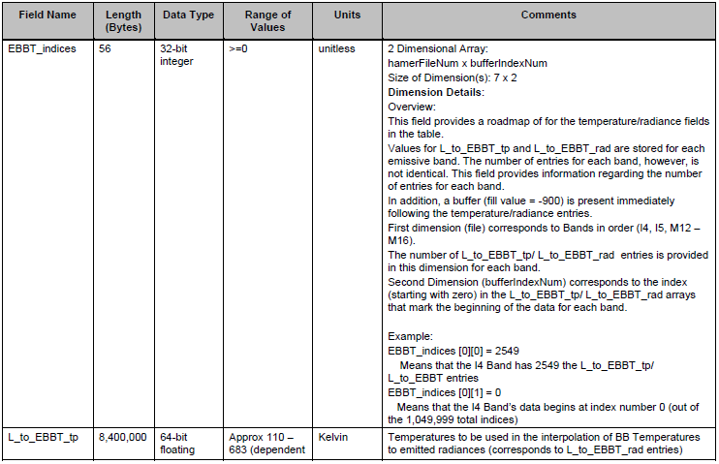
VIIRS Radiance to Effective Blackbody Temperature (EBBT) LUT

Slide 4
VIIRS Radiance to Effective Blackbody Temperature (EBBT) LUT

Slide 5
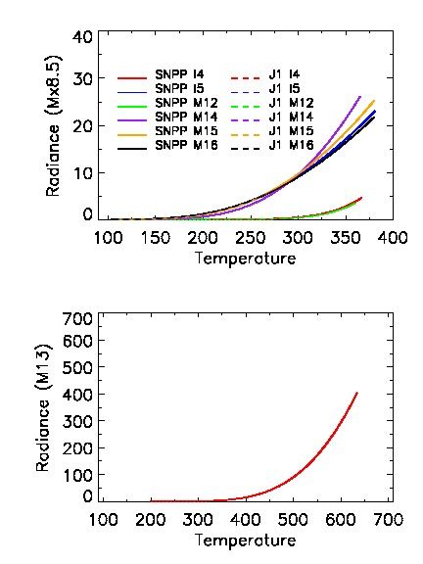
J1 and SNPP Mx8.5 Radiance Comparison
for 7 TEB bands
Top panel: I4, I5, M12, M14, M15, M16
Bottom panel: M13
Radiance vs. Temperatures lines from SNPP and J1 Mx8.5 are almost overlapped.
The following bands have similar radiance and temp ranges:
I4 and M12 (smallest radiance)
I5, M14, M15, and M16
M13 (largest radiance)
5

Slide 6
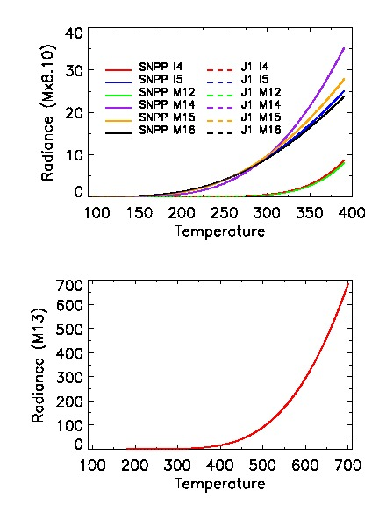
J1 and SNPP Mx8.10 Radiance Comparison
for 7 TEB bands
Mx8.10 LUT has wider temperature and
radiance ranges than Mx8.5.
Radiance vs. Temperatures lines from SNPP and J1 are almost overlapped.
The lines in bands I5, M14, M15, and M16 become more diverge.
I4 and M12 still have the smallest radiance, and M13 has the largest
radiance.
6
6

Slide 7
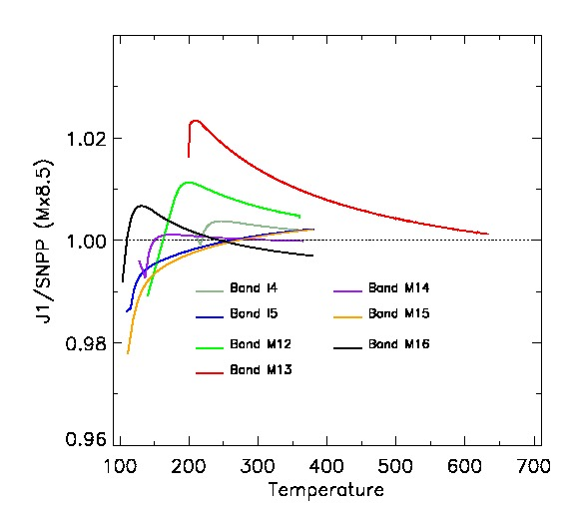
Ratio J1/SNPP for Mx8.5 in 7 TEB bands
At low T, the ratio is large because the radiance is very small.
e.g., for M12,
when Temp=140.00295 K,
Rad _SNPP=1.6135000e-07
Rad_J1=1.5960000e-07
At low T, J1 has smaller radiance than SNPP for most bands except for M13.
M13 has the largest ratio values.
7

Slide 8
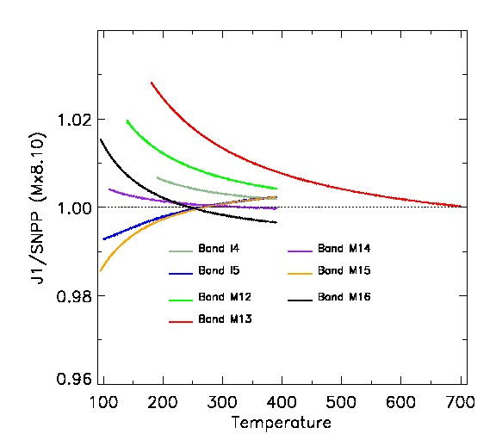
Ratio J1/SNPP for Mx8.10 in 7 TEB bands
The ratio becomes monotonic
function for all bands in Mx8.10.
It should be more reasonable.
The ratios in M15 and M16 have converse pattern.
At the very T, J1 has smaller radiance than SNPP for I4 and M15, but J1 has larger radiance for other bands.

Slide 9
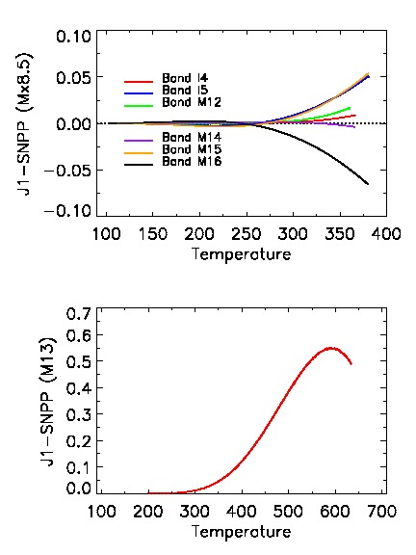
Difference J1−SNPP (Mx8.5) for 7 TEB bands
Top panel: I4, I5, M12, M14, M15, M16
Bottom panel: M13
The radiance difference is a monotonic
function for most TEB bands except for
M13.
The absolute radiance difference is large
at high T.
At high T, J1 has smaller radiance than
SNPP in M14 and M16, but has larger
radiance in other TEB bands.

Slide 10
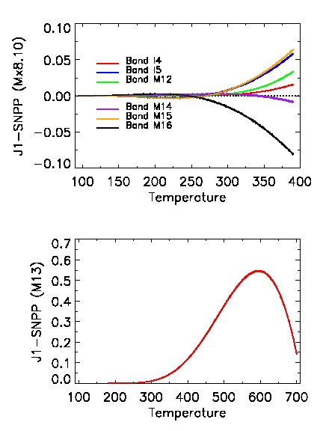
Difference J1−SNPP (Mx8.10) for 7 TEB bands
Mx 8.10 has similar radiance difference patterns as Mx8.5.
In M13, the largest radiance difference is 0.55 W/m²-μm-Sr
at around 600K.
At high temperature, I5, M15 and M16 have larger radiance than I4, M12, and M14.
The difference may caused by different Spectral Response Function
(SRF) between SNPP and J1 VIIRS.
10

