Slide 1
JPSS-1 vs S-NPP VIIRS SDR LUT Comparison: VIIRS-SDR-DELTA-C-LUT
Zhuo (Julie) Wang^{1,2}, Changyong Cao³, and Slawomir Blonski^{1,2}
¹CICS/ESSIC, University of Maryland, College Park
²NOAA/NESDIS/STAR Affiliate
³ NOAA/NESDIS/STAR
October 6, 2015

Slide 2
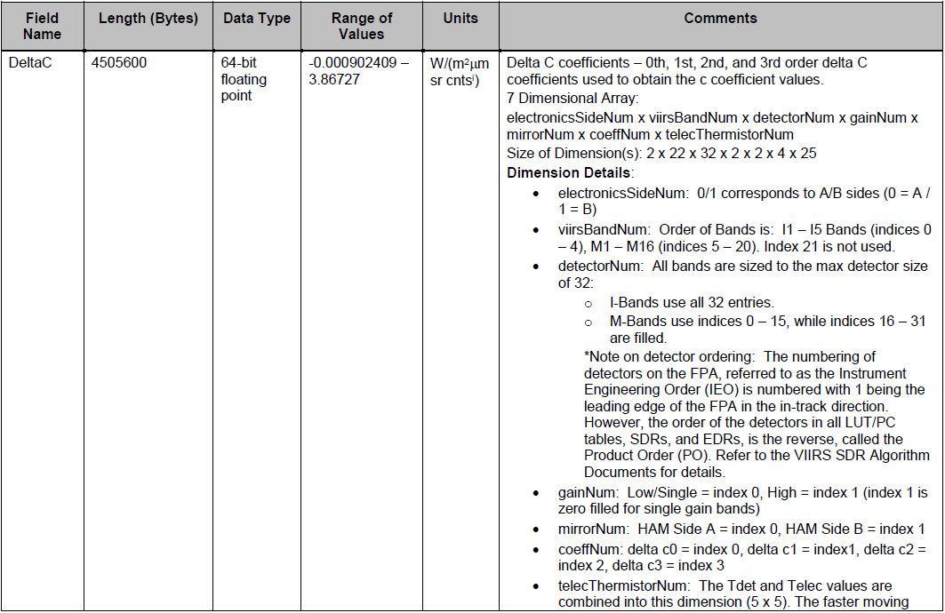
VIIRS-SDR-DELTA-C-LUT
2
2

Slide 3
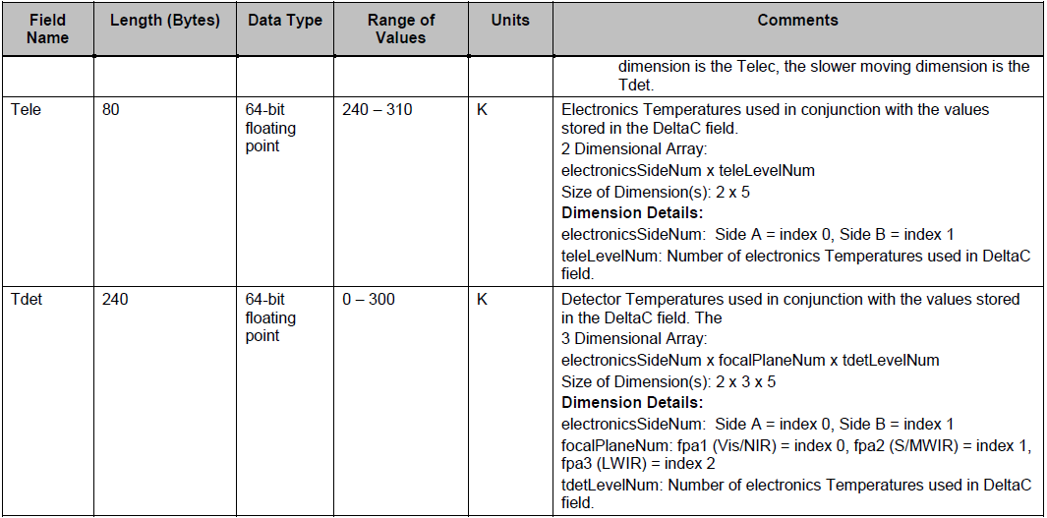
VIIRS-SDR-DELTA-C-LUT
Tdet and Telec values are combined into the dimension (5×5)
The fast moving dimension is the Telec, the slower moving dimension is the Tdet.
3
3
3

Slide 4
VIIRS-SDR-DELTA-C-LUT
Names of the compared LUT files:
S-NPP:
55142d4b-5aee5-9d9b6c03-b3a25f23.VIIRS-SDR-DELTA-C-LUT_J01_20140401000000Z_20140401000000Z_ee00000000000000Z_PS-1-0-CCR-14-1698-JPSS-DPA-003-PE-_adv-_ops_all-_all.bin
JPSS-1:
VIIRS-SDR-DELTA-C-LUT_j01_20150724000000Z_20150724000000Z_ee00000000000000Z_PS-v1-BE-PE-_all-_dev_all-_all.bin
4
4

Slide 5
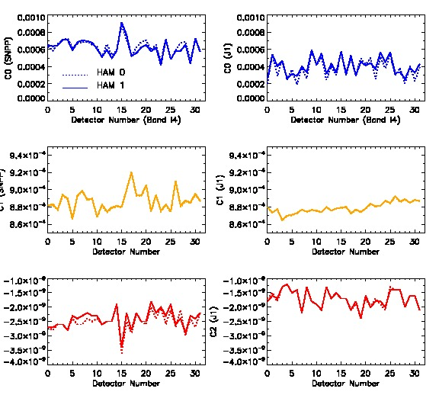
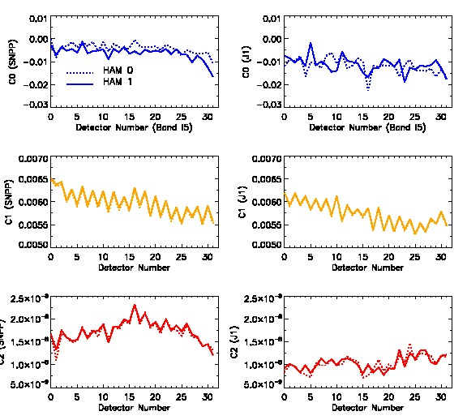
Coefficients vs. Detector in I4 and I5
for SNPP and J1 (Central Point of 5×5 array)
HAM side A has slightly larger variation than side B, and overall they are very close.
C0 is larger than C1, and C2 for I4 and I5 bands.
J1 has more obvious odd/even detector pattern than SNPP for C0.
C1 in I5 has obvious odd/even pattern.
The variation of C1 in J1 is smaller than in SNPP for I4.

Slide 6
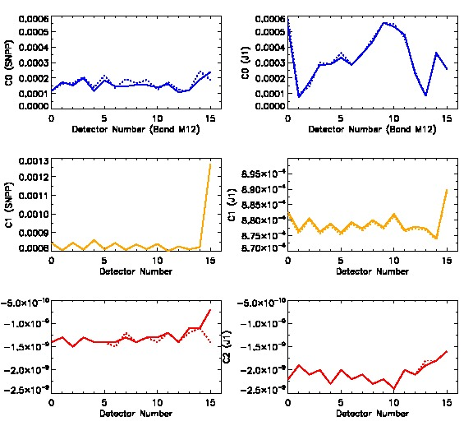
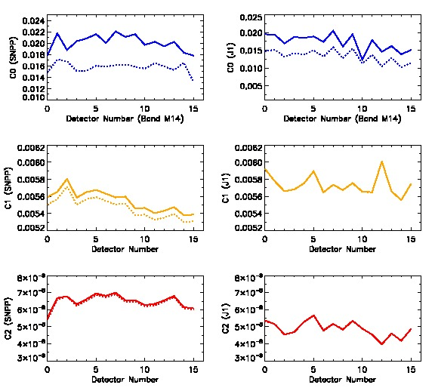
Coefficients vs. Detector in M12 and M14
for SNPP and J1
C0 is smaller than C1 in M12, but larger than C0 in M14.
C1 shows large difference for two HAM sides in M14.
J1 has larger variation in C0 and C1 than SNPP for both bands.

Slide 7
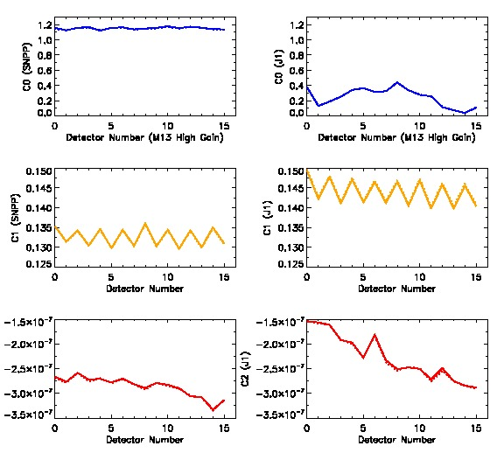
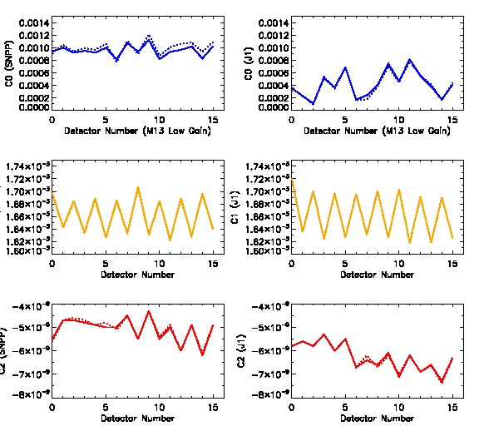
Coefficients vs. Detector in M13
High Gain and Low Gain for SNPP and J1
C0 is larger than C1 and C2 in M13.
J1 has smaller C0 than SNPP for both high gain and low gain in M13.
C1 show apparent odd/even pattern.

Slide 8
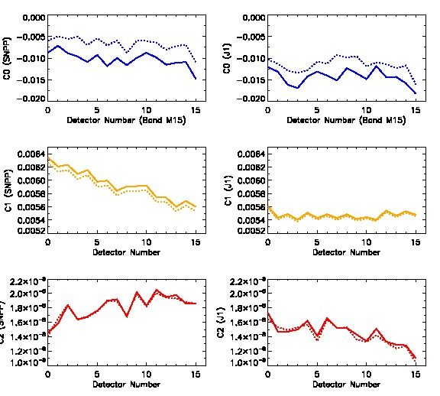
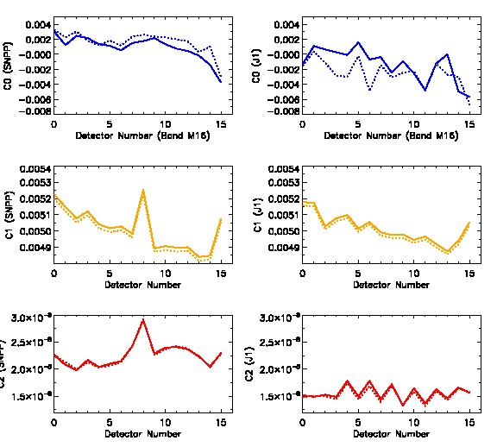
Coefficients vs. Detector in M15 and M16
for SNPP and J1
C1 shows obvious difference for two HAM sides in M15 and M16.
In M15, J1 has smaller coefficients than SNPP.

Slide 9
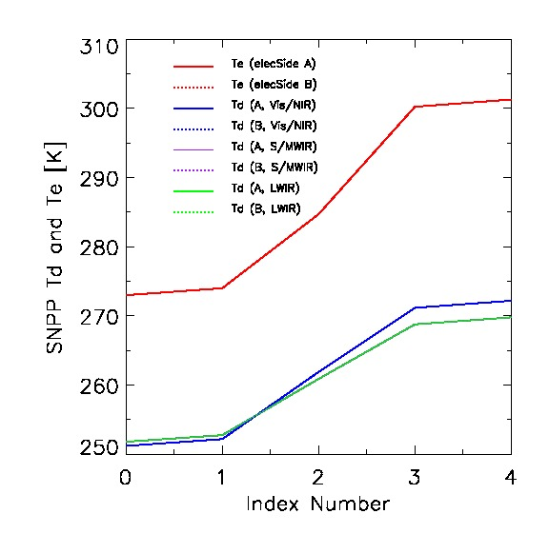
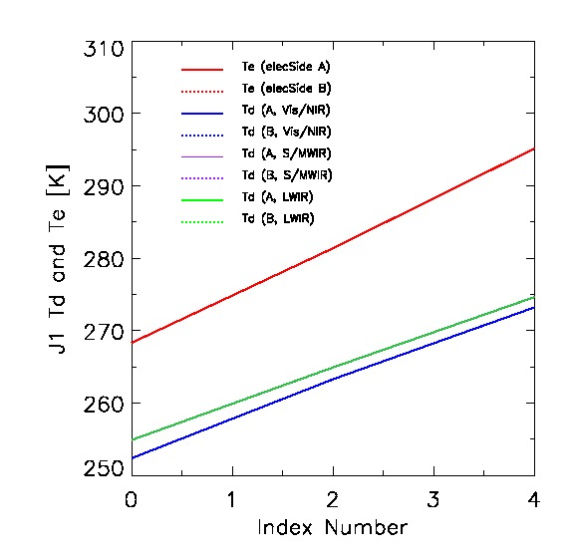
Tdet and Telec for SNPP and J1
Tdet values for focal plane (S/MWIP) and (LWIR) are same. There is no difference
between electronic side A and B.
For SNPP, Tdet and Telec changes non-linearly. For J1, it uses the extrapolation and
temperature changes linearly.

Slide 10
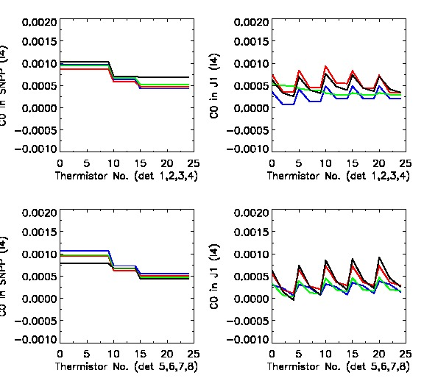
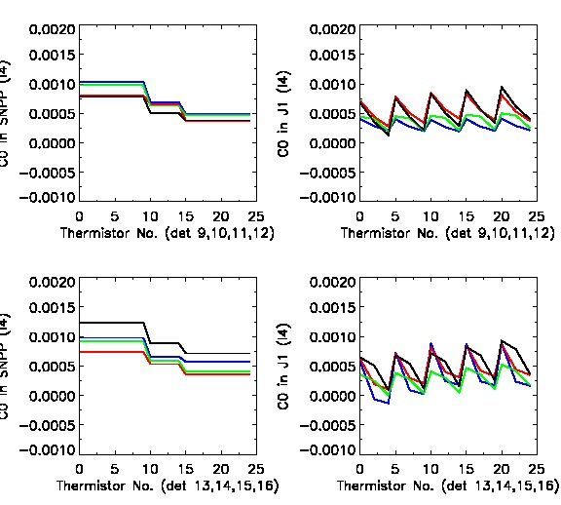
C0 for 25 Thermistors in Band I4
(Detectors 1-16)
Detectors 1-8 Detectors 9-16
S-NPP J1 S-NPP J1
For 25 thermoistors, Telec is faster moving dimension, Tdet is slow moving dimension.
For SNPP, C0 depends on Tdet much more than on Telec.
For J1, C0 depends on both Tdet and Tele, and it changes with Telec faster.

Slide 11
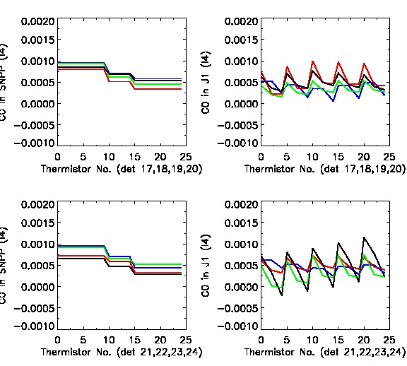
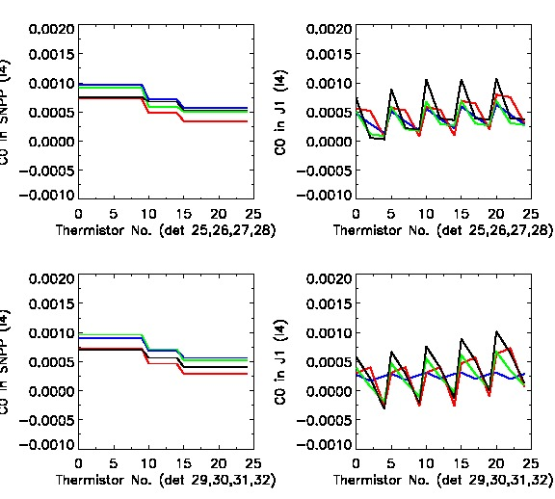
C0 for 25 Thermistors in Band I4
(Detectors 17-32)
Detectors 17-24 Detectors 25-32
S-NPP J1 S-NPP J1
C0 changes for different detectors. Not linearly changed.
11

Slide 12
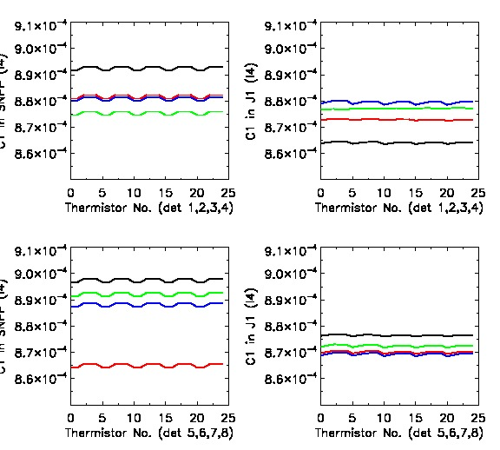
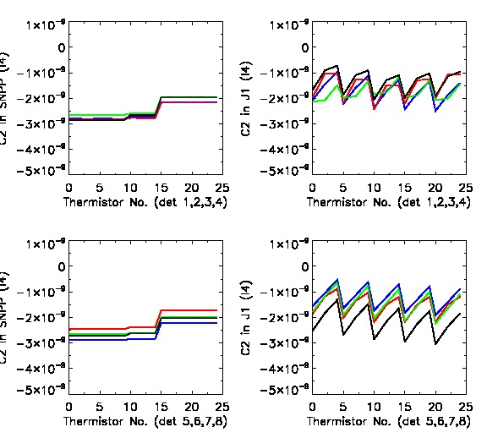
C1 and C2 in Band I4 for 8 Detectors
C1 C2
S-NPP J1 S-NPP J1
J1 and SNPP have similar pattern for C1.
C2 in J1 depends on Telec much more than in SNPP.
12
12

Slide 13
Table 1. Max absolute difference in C0 (J1−SNPP)
for electronic side 0 and HAM A in 7 thermal bands (detectors 1-16).
 | I4 | I5 | M12 | M13 (Low Gain) | M13 (High Gain) | M14 | M15 | M16
Det 1 | 0.0008981 | 0.0117500 | 0.0017413 | 0.0009623 | 2.1089302 | 0.0130577 | 0.0064297 | 0.0047843
Det 2 | 0.0005223 | 0.0056674 | 0.0006470 | 0.0009681 | 2.2734311 | 0.0102190 | 0.0073756 | 0.0019073
Det 3 | 0.0005659 | 0.0066588 | 0.0004713 | 0.0010944 | 2.1316698 | 0.0087228 | 0.0079237 | 0.0068979
Det 4 | 0.0007779 | 0.0042745 | 0.0005871 | 0.0006532 | 2.1512191 | 0.0133666 | 0.0127096 | 0.0058998
Det 5 | 0.0010081 | 0.0149339 | 0.0007984 | 0.0011273 | 2.0420304 | 0.0134143 | 0.0073589 | 0.0050876
Det 6 | 0.0008374 | 0.0080666 | 0.0005695 | 0.0004133 | 1.9660438 | 0.0145268 | 0.0070410 | 0.0030882
Det 7 | 0.0009393 | 0.0125657 | 0.0006891 | 0.0007534 | 2.0416216 | 0.0120132 | 0.0073081 | 0.0060487
Det 8 | 0.0008284 | 0.0109916 | 0.0004000 | 0.0010614 | 2.0706121 | 0.0161928 | 0.0046466 | 0.0047131
Det 9 | 0.0008357 | 0.0061672 | 0.0008580 | 0.0010552 | 1.9441093 | 0.0093559 | 0.0047175 | 0.0065376
Det 10 | 0.0005270 | 0.0049645 | 0.0008651 | 0.0006363 | 2.0315952 | 0.0155979 | 0.0103224 | 0.0048502
Det 11 | 0.0007880 | 0.0093851 | 0.0012113 | 0.0009745 | 2.0836038 | 0.0088616 | 0.0086322 | 0.0050515
Det 12 | 0.0006457 | 0.0019894 | 0.0006750 | 0.0005016 | 2.0812533 | 0.0100192 | 0.0064867 | 0.0073298
Det 13 | 0.0011106 | 0.0110449 | 0.0006067 | 0.0008444 | 2.1811591 | 0.0098007 | 0.0043259 | 0.0035169
Det 14 | 0.0006406 | 0.0087720 | 0.0005748 | 0.0008866 | 2.2776978 | 0.0099278 | 0.0078472 | 0.0033306
Det 15 | 0.0009148 | 0.0038038 | 0.0003694 | 0.0008426 | 2.2804623 | 0.0097738 | 0.0062920 | 0.0046352
Det 16 | 0.0011528 | 0.0071842 | 0.0005722 | 0.0008501 | 2.2728458 | 0.0098672 | 0.0067555 | 0.0058064

Slide 14
Table 2. Max absolute difference in C0 between SNPP and J1 (J1−SNPP)
for electronic side 0 and HAM A in 7 thermal bands (detectors 71-32).
 | I4 | I5
Det 17 | 0.0008114 | 0.0223265
Det 18 | 0.0006341 | 0.0113071
Det 19 | 0.0007757 | 0.0101328
Det 20 | 0.0005631 | 0.0088899
Det 21 | 0.0006178 | 0.0088062
Det 22 | 0.0003975 | 0.0095467
Det 23 | 0.0009523 | 0.0139569
Det 24 | 0.0008636 | 0.0094625
Det 25 | 0.0008249 | 0.0073471
Det 26 | 0.0006556 | 0.0064393
Det 27 | 0.0008340 | 0.0097484
Det 28 | 0.0007251 | 0.0109196
Det 29 | 0.0007345 | 0.0082833
Det 30 | 0.0009879 | 0.0102638
Det 31 | 0.0011451 | 0.0075847
Det 32 | 0.0010215 | 0.0059973

Slide 15
Backup Slides

Slide 16
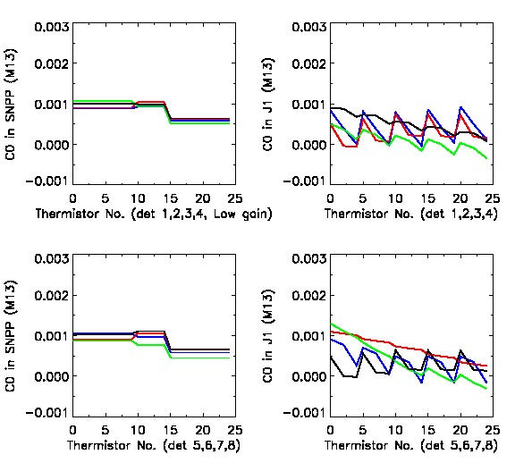
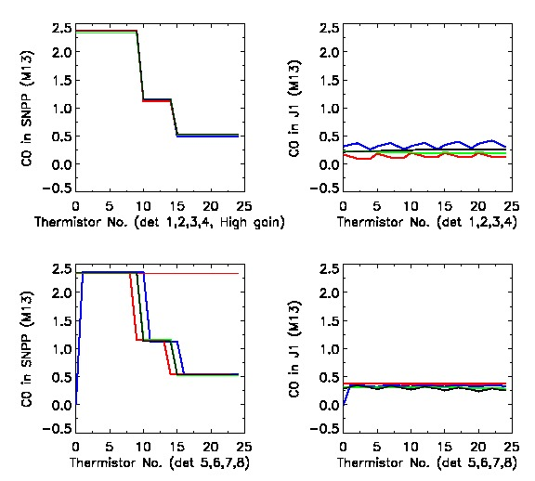
C0 in Band M13 for 8 Detectors
Low Gain High Gain
S-NPP J1 S-NPP J1
16
16

Slide 17
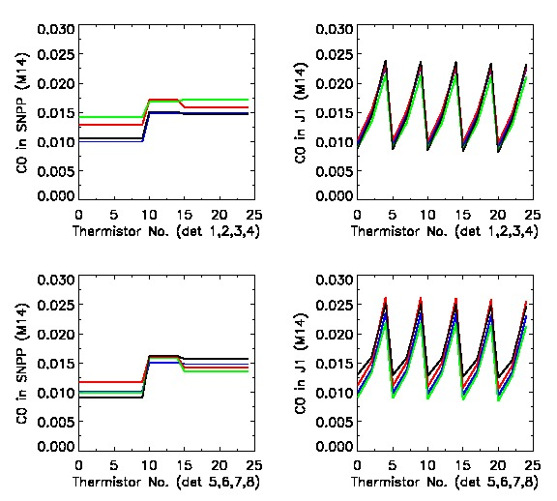
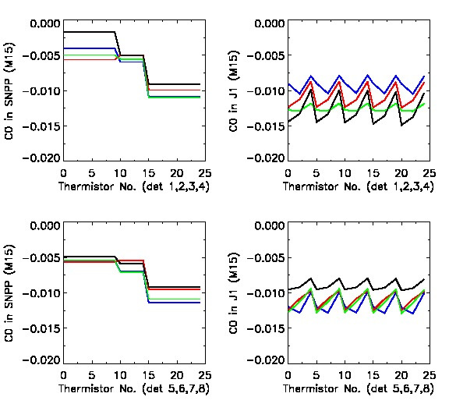
C0 in Band M14 and M15 for 8 Detectors
M14 M15
S-NPP J1 S-NPP J1
17
17

Slide 18
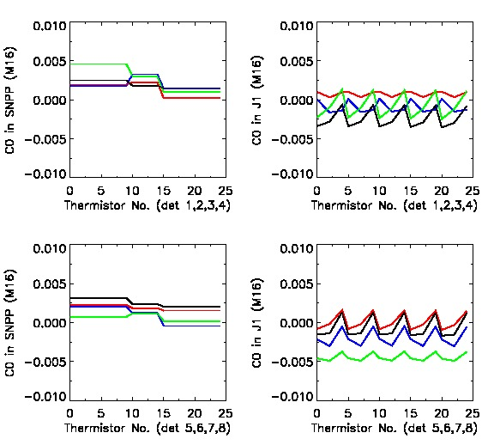
C0 in Band M16 for 8 Detectors
M16
S-NPP J1
18
18
18

Slide 19
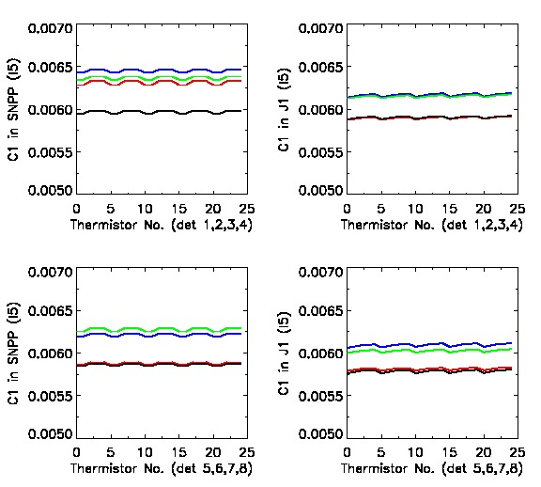
C1 in Band I4 and I5 for 8 Detectors
I4 I5
S-NPP J1 S-NPP J1
19
19

Slide 20
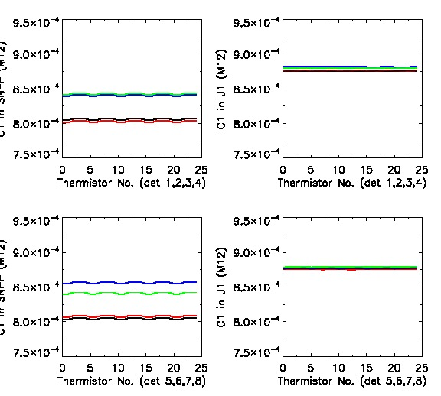
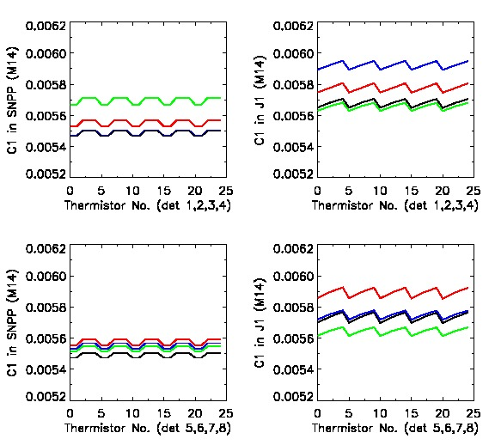
C1 in Band M12 and M14 for 8 Detectors
M12 M14
S-NPP J1 S-NPP J1
20
20
20

Slide 21
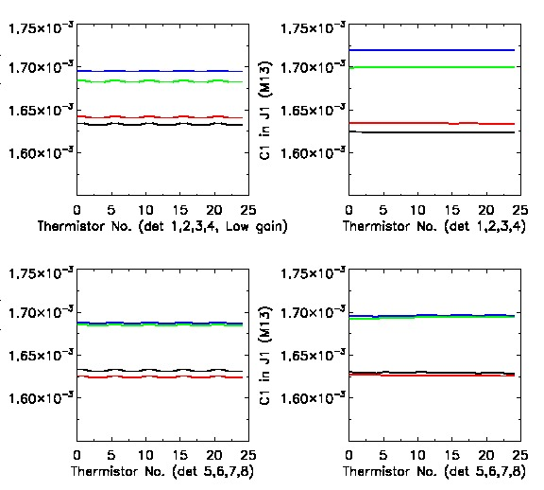
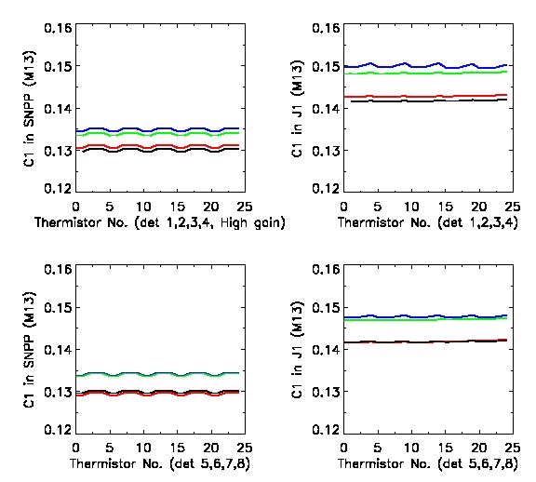
C1 in Band M13 for 8 Detectors
Low Gain High Gain
S-NPP J1 S-NPP J1
21
21
21
21

Slide 22
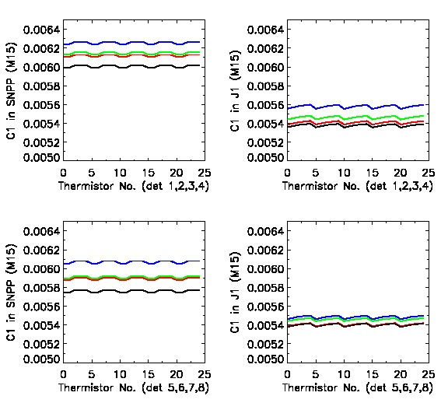
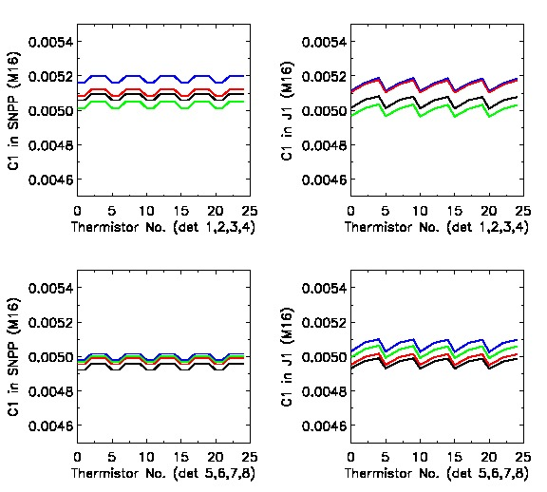
C1 in Band M15 and M16 for 8 Detectors
M15 M16
S-NPP J1 S-NPP J1
22
22
22

Slide 23
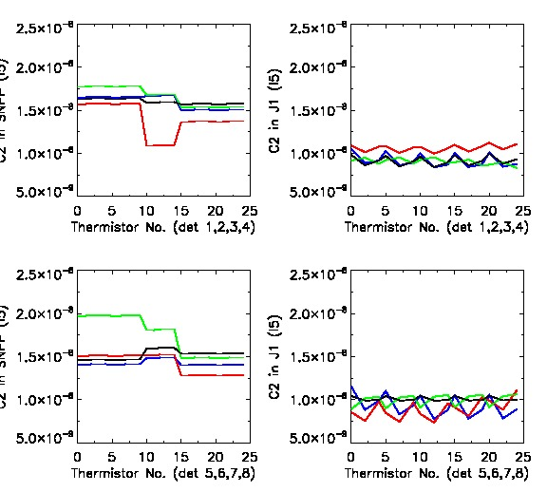
C2 in Band I4 and I5 for 8 Detectors
I4 I5
S-NPP J1 S-NPP J1
23
23
23

Slide 24
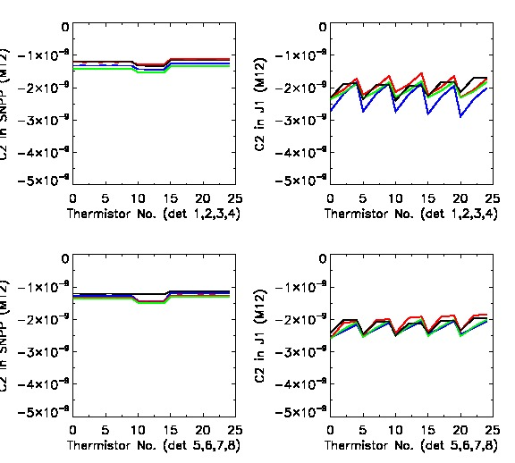
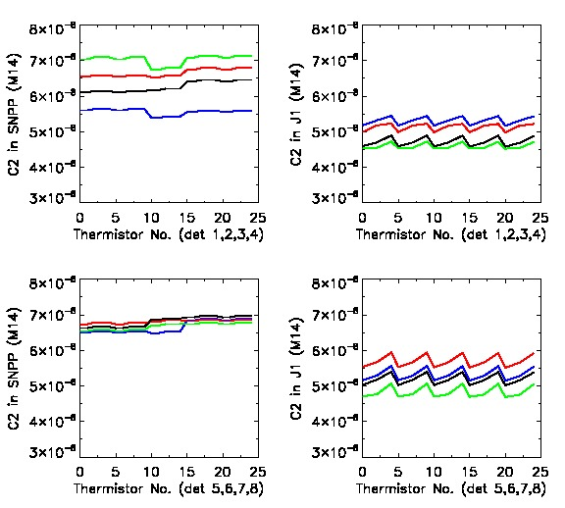
C2 in Band M12 and M14 for 8 Detectors
M12 M14
S-NPP J1 S-NPP J1
24
24
24

Slide 25
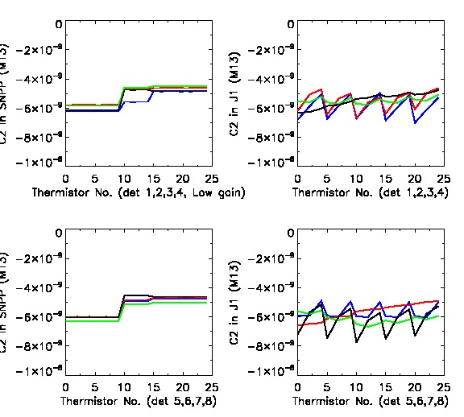
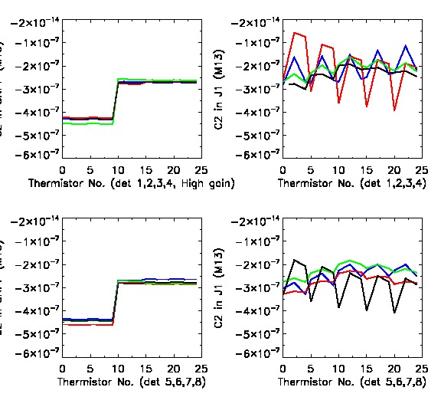
C2 in Band M13 for 8 Detectors
Low Gain High Gain
S-NPP J1 S-NPP J1
25
25
25
25
25

Slide 26
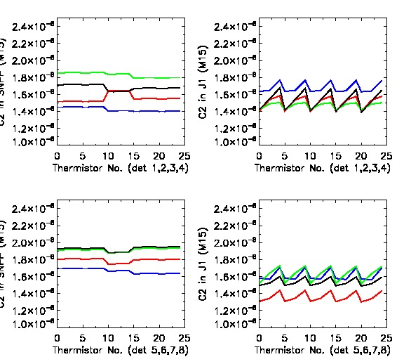
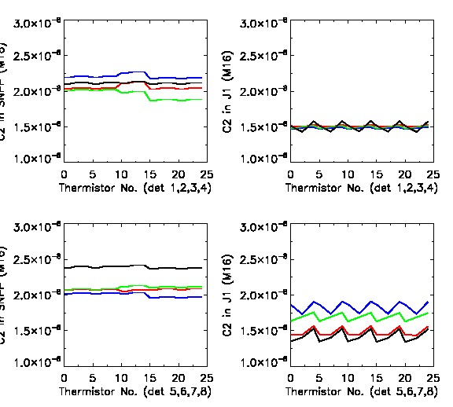
C2 in Band M15 and M16 for 8 Detectors
M15 M16
S-NPP J1 S-NPP J1
26
26
26
26

Slide 27
Table 3. Difference in Coefficient C0 between SNPP and J1 (J1−SNPP)
for electronic side 0 and HAM A in band I4, I5, and M13 (detectors 1-16)
 | I4 |  | I5 |  | M13
 | Min | Max | Min | Max | Min | Max | Min | Max
Det 1 | -0.0008981 | 0.0000564 | -0.0117500 | -0.0069053 | -0.0009623 | 0.0003428 | -2.1089302 | -0.0763845
Det 2 | -0.0005223 | 0.0003547 | -0.0056674 | -0.0001570 | -0.0009681 | 0.0001097 | -2.2734311 | -0.3162389
Det 3 | -0.0005659 | -0.0001833 | -0.0066588 | -0.0031281 | -0.0010944 | -0.0003935 | -2.1316698 | -0.3142477
Det 4 | -0.0007779 | 0.0000542 | -0.0042745 | -0.0023003 | -0.0006532 | -0.0001067 | -2.1512191 | -0.2746132
Det 5 | -0.0010081 | -0.0001695 | -0.0149339 | -0.0085352 | -0.0011273 | -0.0000949 | -2.0420304 | -0.1962058
Det 6 | -0.0008374 | 0.0002186 | -0.0080666 | -0.0021213 | -0.0004133 | 0.0001957 | -1.9660438 | -0.1699915
Det 7 | -0.0009393 | -0.0000128 | -0.0125657 | -0.0066275 | -0.0007534 | 0.0004247 | -2.0416216 | -0.2238944
Det 8 | -0.0008284 | 0.0004814 | -0.0109916 | -0.0060828 | -0.0010614 | -0.0000226 | -2.0706121 | -0.2274314
Det 9 | -0.0008357 | -0.0000752 | -0.0061672 | 0.0015801 | -0.0010552 | 0.0001521 | -1.9441093 | -0.0606544
Det 10 | -0.0005270 | 0.0004568 | -0.0049645 | 0.0020757 | -0.0006363 | -0.0000597 | -2.0315952 | -0.1711044
Det 11 | -0.0007880 | 0.0000230 | -0.0093851 | -0.0004865 | -0.0009745 | 0.0001020 | -2.0836038 | -0.2102577
Det 12 | -0.0006457 | 0.0005635 | -0.0019894 | -0.0001835 | -0.0005016 | 0.0000249 | -2.0812533 | -0.2099506
Det 13 | -0.0011106 | 0.0003069 | -0.0110449 | -0.0096626 | -0.0008444 | -0.0001919 | -2.1811591 | -0.4090631
Det 14 | -0.0006406 | 0.0005028 | -0.0087720 | -0.0066181 | -0.0008866 | 0.0001385 | -2.2776978 | -0.4044080
Det 15 | -0.0009148 | 0.0001193 | -0.0038038 | -0.0012532 | -0.0008426 | -0.0000698 | -2.2804623 | -0.4451785
Det 16 | -0.0011528 | 0.0002097 | -0.0071842 | 0.0001730 | -0.0008501 | -0.0001133 | -2.2728458 | -0.4394718

Slide 28
Table 4. Difference in Coefficient C0 between SNPP and J1 (J1−SNPP)
for electronic side 0 and HAM A in band I4, I5, and M13 (detectors 17-32).
 | I4 |  | I5
 | Min | Max | Min | Max
Det 17 | -0.0008114 | -0.0000948 | -0.0223265 | -0.0154280
Det 18 | -0.0005816 | 0.0006341 | -0.0113071 | -0.0073423
Det 19 | -0.0007757 | 0.0000839 | -0.0101328 | -0.0056116
Det 20 | -0.0005631 | 0.0001779 | -0.0088899 | -0.0063240
Det 21 | -0.0006178 | 0.0000638 | -0.0088062 | -0.0043557
Det 22 | -0.0003975 | 0.0003698 | -0.0095467 | -0.0064543
Det 23 | -0.0009523 | 0.0002247 | -0.0139569 | -0.0062303
Det 24 | -0.0008636 | 0.0008555 | -0.0094625 | -0.0036551
Det 25 | -0.0008249 | 0.0000657 | -0.0073471 | -0.0003788
Det 26 | -0.0006556 | 0.0004532 | -0.0064393 | 0.0009065
Det 27 | -0.0008340 | 0.0001837 | -0.0097484 | -0.0047544
Det 28 | -0.0007251 | 0.0005388 | -0.0109196 | -0.0062529
Det 29 | -0.0007345 | -0.0002535 | -0.0082833 | -0.0055653
Det 30 | -0.0009879 | 0.0004408 | -0.0102638 | -0.0065288
Det 31 | -0.0011451 | 0.0001462 | -0.0075847 | -0.0031178
Det 32 | -0.0010215 | 0.0006064 | -0.0059973 | 0.0001387

Slide 29
Table 5. Difference in Coefficient C0 between SNPP and J1 (J1−SNPP)
for electronic side 0 and HAM A in band M12, M14, M15 and M16.
 | M12 |  | M14 |  | M15 |  | M16
 | Min | Max | Min | Max | Min | Max | Min | Max
Det 1 | -0.0007406 | 0.0017413 | -0.0057729 | 0.0130577 | -0.0064297 | 0.0029793 | -0.0047843 | -0.0012804
Det 2 | -0.0006470 | 0.0004811 | -0.0071596 | 0.0102190 | -0.0073756 | 0.0011472 | -0.0019073 | 0.0008397
 | -0.0003183 | 0.0004713 | -0.0087228 | 0.0073226 | -0.0079237 | -0.0008976 | -0.0068979 | 0.0001660
Det 4 | -0.0001758 | 0.0005871 | -0.0065538 | 0.0133666 | -0.0127096 | -0.0011077 | -0.0058998 | -0.0022497
Det 5 | -0.0000329 | 0.0007984 | -0.0054288 | 0.0134143 | -0.0073589 | 0.0014215 | -0.0050876 | -0.0000843
Det 6 | -0.0001000 | 0.0005695 | -0.0050308 | 0.0145268 | -0.0070410 | -0.0002790 | -0.0030882 | -0.0000185
Det 7 | -0.0001940 | 0.0006891 | -0.0069038 | 0.0120132 | -0.0073081 | 0.0013552 | -0.0060487 | -0.0039426
Det 8 | -0.0000773 | 0.0004000 | -0.0033307 | 0.0161928 | -0.0046466 | 0.0011636 | -0.0047131 | -0.0007946
Det 9 | -0.0001255 | 0.0008580 | -0.0085287 | 0.0093559 | -0.0034894 | 0.0047175 | -0.0065376 | -0.0042357
Det 10 | -0.0001870 | 0.0008651 | -0.0048324 | 0.0155979 | -0.0103224 | -0.0004738 | -0.0048502 | -0.0023077
Det 11 | -0.0003160 | 0.0012113 | -0.0088616 | 0.0081636 | -0.0086322 | -0.0005916 | -0.0050515 | -0.0004978
Det 12 | -0.0002323 | 0.0006750 | -0.0076951 | 0.0100192 | -0.0064867 | 0.0009839 | -0.0073298 | -0.0043482
Det 13 | -0.0002880 | 0.0006067 | -0.0098007 | 0.0063040 | -0.0043259 | 0.0019500 | -0.0035169 | -0.0004704
Det 14 | -0.0004748 | 0.0005748 | -0.0078729 | 0.0099278 | -0.0078472 | -0.0003934 | -0.0033306 | 0.0005461
Det 15 | -0.0001805 | 0.0003694 | -0.0097329 | 0.0097738 | -0.0062920 | 0.0007964 | -0.0046352 | -0.0011453
Det 16 | -0.0003614 | 0.0005722 | -0.0054762 | 0.0098672 | -0.0067555 | 0.0021724 | -0.0058064 | -0.0008853

